Slide 1

GLM
Lecture 7
LSM3257
AY22/23; Sem 2 | Ian Z.W. Chan

Slide 2

Advanced analyses – Analysis decision tree
(will be modified further)
Normally distributed (errors):
Regression^*
Not normally distributed (errors):
Generalised Linear Model (GLM) with error structure to be determined by you
Start
All Continuous
Response variable type
Continuous
Explanatory variables types
All Categorical
Normally distributed (response):
Analysis of variance (ANOVA)^*
Not normally distributed (response):
Kruskal-Wallis test or GLM
Categorical
Continuous and Categorical
Time to Death
Count
Number of categories
Normally distributed (response):
Analysis of covariance (ANCOVA)^*
Not normally distributed (response):
Rank-based ANCOVA (RANCOVA) or
GLM with error structure to be determined by you
Proportion
2
>2
GLM with Poisson errors (aka Poisson regression)
No
^Heteroscedasticity: use GLS
*Random effects: use LME
Overdispersion present?
GLM with Binomial errors (aka Binary Logistic regression)
Yes
Survival Analysis
GLM with Binomial errors (aka Logistic regression)
GLM with Quasi-Poisson errors or
GLM with Negative Binomial errors
GLM with Multinomial errors (aka Multinomial Logistic regression)

Slide 3
Summary (Learning Objectives)
Generalised Linear Models (GLM)
- Theory: Link functions, linear predictors and error distributions
Error distributions and variable types
Least Squares vs. Maximum Likelihood
- Poisson for count data
Quasipoisson/Negative Binomial for overdispersion
Simplifying, comparing, checking and interpreting models
- Binomial for proportion/categorical data (2 categories)
Quasibinomial for overdispersion
Simplifying, comparing, checking and interpreting models
- Multinomial for categorical data (>2 categories)
- Quasi as a last resort for non-normally distributed continuous data

Slide 4
GLM
Theoretical background

Slide 5
How are GLMs related to Regression, ANOVA and ANCOVA?
Another name for normally-distributed
Regression
ANOVA
ANCOVA
But Biology is messy!: there are many types of response variables with non-normal, heteroscedastic error distributions (aka error structures).
Nelder & Wedderburn (1972) created a Generalised Linear Model (GLM) to analyse these different variables: you just need to specify an appropriate error distribution for the type of variable you have.
All equivalent to
Linear Models that have Gaussian errors.
Assumptions Response variable: one continuous variable with normally distributed errors.
Explanatory variables: one or more continuous or categorical variables.
Homoscedasticity and normality are assumed.
Notes:
Generalized Linear Models Author(s): J. A. Nelder and R. W. M. Wedderburn Source: Journal of the Royal Statistical Society. Series A (General), Vol. 135, No. 3 (1972), pp. 370-384

Slide 6
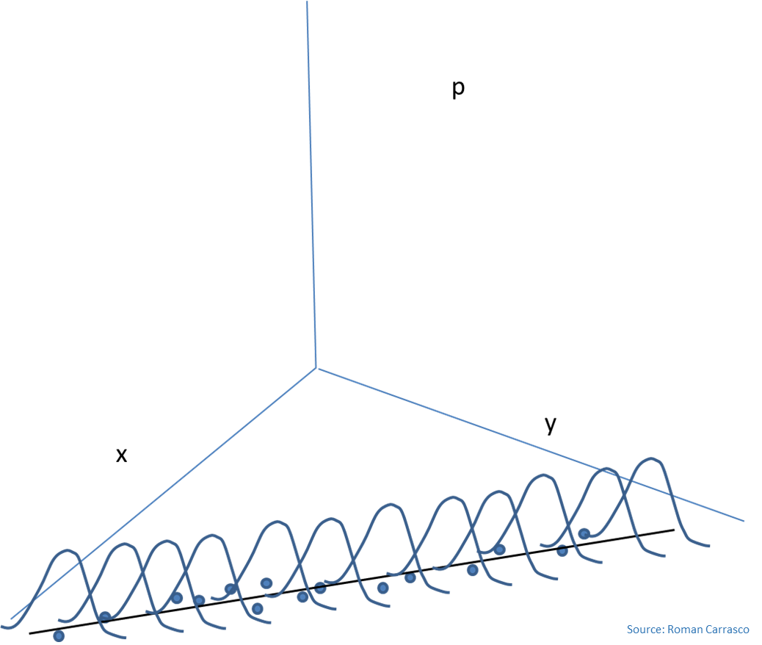



What is a GLM?
A GLM uses a linear predictor to model values of the response variable using a link function and an assumed error distribution. An example formula is shown below (note the arrows instead of an equals sign).
B) Activation function: convert the values of the linear predictor into the type of values we are expecting in our data.
Example: if our data is a proportion, we need values between 0 and 1. But we know a linear predictor can take values from -∞ to +∞. So we need a function to convert the values.
A) Linear predictor: the same thing we are familiar with in regression, ANOVA and ANCOVA: they have a constant and slopes to help explain the effects of the explanatory variables on the response variable. Note: we still want a linear predictor because it makes things easier to explain and understand.
$$→$$
$$Y_{i} β_{0}+β_{1}X_{1,i}+β_{2}X_{2,i}…β_{n}X_{n,i}+ε_{i}$$
$$→$$
D) Error distribution: different distributions are known to model (the errors from) different types of data better:
1) We choose a distribution based on the data we have.
2) When we choose a certain error distribution, we usually use a certain link function, this is called the “canonical link function”.
(Note: Run ?family in R to see the different types.)
C) Link function: convert values in our data to the values in the linear predictor. This is the inverse of the Activation function. We usually talk about Link functions rather than Activation functions.
Notes:
Generalized Linear Models Author(s): J. A. Nelder and R. W. M. Wedderburn Source: Journal of the Royal Statistical Society. Series A (General), Vol. 135, No. 3 (1972), pp. 370-384

Slide 7
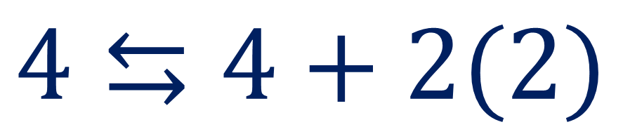
De-mystifying “Link Functions”
What are the Activation (←) and Link (→) functions for the model below?
Left-Hand Side: our response variable
÷2
Answer
$$4⇆4+2(2)$$
x2
Answer
Right-Hand Side: our linear predictor

Slide 8
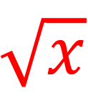
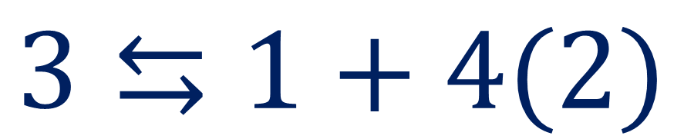
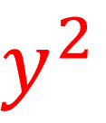
De-mystifying “Link Functions”
What are the Activation (←) and Link (→) functions for the model below?
$$\sqrt{x}$$
Answer
$$3⇆1+4(2)$$
$$y^{2}$$
Answer

Slide 9

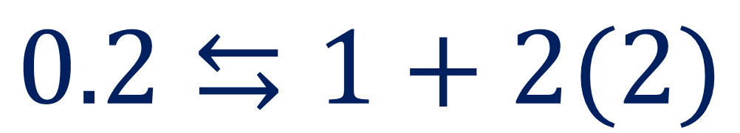

De-mystifying “Link Functions”
What are the Activation (←) and Link (→) functions for the model below?
$$\frac{1}{x}$$
Answer
$$0.2⇆1+2(2)$$
$$\frac{1}{y}$$
Answer

Slide 10
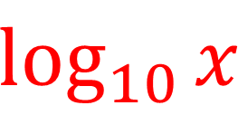
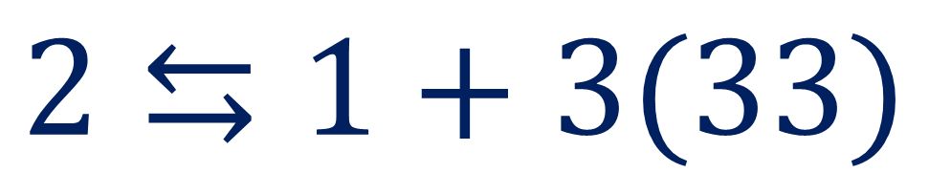
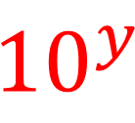
De-mystifying “Link Functions”
What are the Activation (←) and Link (→) functions for the model below?
$$\log_{10}{x}$$
Answer
$$2⇆1+3(33)$$
$${10}^{y}$$
Answer

Slide 11

De-mystifying “Link Functions”
What are the Activation (←) and Link (→) functions for the model below?
Identity
Answer
$$13⇆1+4(3)$$
Identity
Answer

Slide 12
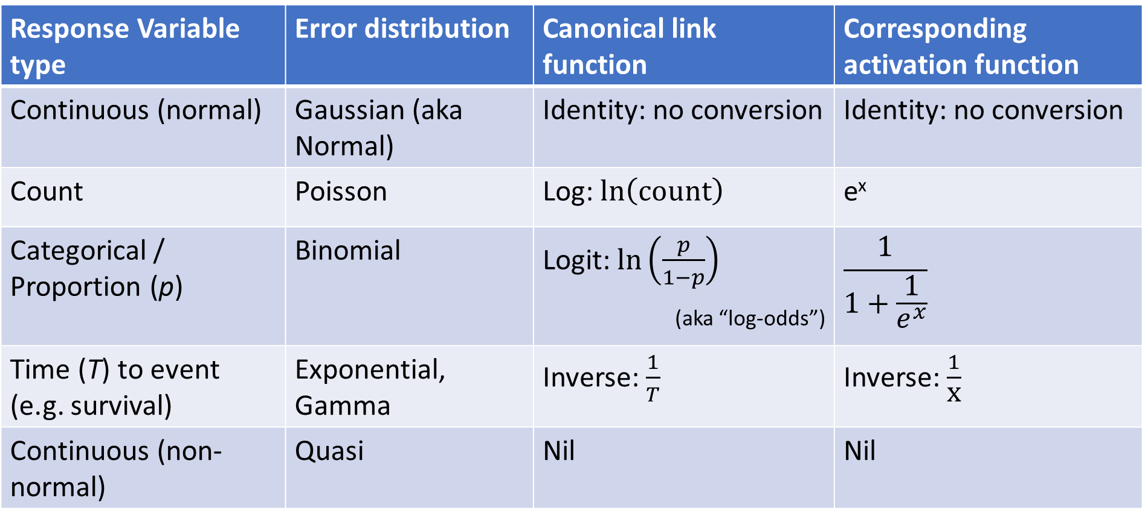
Variable types and Error Distributions
Response Variable type | Error distribution | Canonical link function | Corresponding activation function
Continuous (normal) | Gaussian (aka Normal) | Identity: no conversion | Identity: no conversion
Count | Poisson | Log: $\ln\left(\text{count}\right)$ | e^{x}
Categorical / Proportion (p) | Binomial | Logit: $\ln\left(\frac{p}{1−p}\right)$ (aka “log-odds”) | $$\frac{1}{1+\frac{1}{e^{x}}}$$
Time (T) to event (e.g. survival) | Exponential, Gamma | Inverse: $\frac{1}{T}$ | Inverse: $\frac{1}{\text{x}}$
Continuous (non-normal) | Quasi | Nil | Nil
Note: you can see what error families are available, and what link functions can be applied to each family using “?family”.

Slide 13
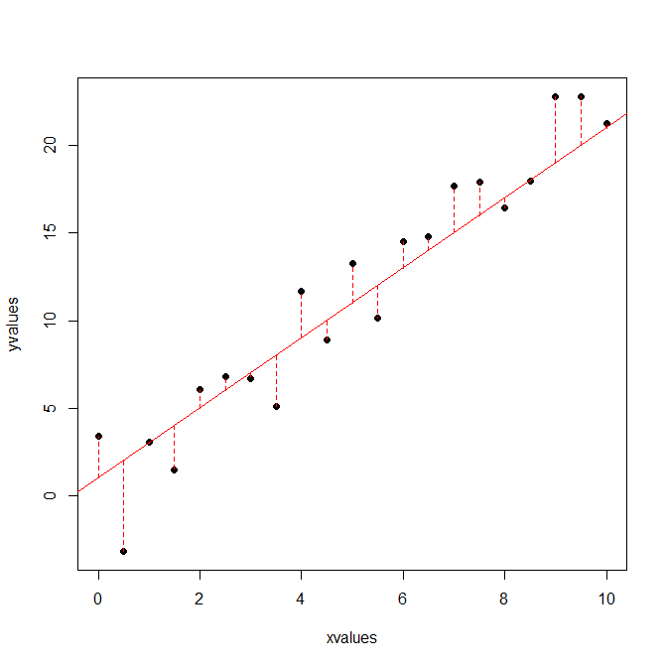


How are GLM models chosen? – Maximum Likelihood Estimation
GLMs give a model that maximises the likelihood (L) of predicting the data. The exact formula is different for every distribution.
Example: for a normal distribution, the likelihood function is:
Recall that regression, ANOVA and ANCOVA use Least Squares, i.e. minimising SSE.
When (and only when) a normal distribution is used, Maximum Likelihood Estimation is equivalent to Least Squares, i.e. GLM with Gaussian errors = LM.
$$L=\frac{1}{{\left(2π\right)}^{\frac{n}{2}}σ^{N}}∙e^{(\frac{−1}{2σ^{2}}\left(\sum_{i=1}^{N}{ε^{2}}\right))}$$
Notice that likelihood (L) is maximized when this term is minimized.
$$\text{SSE}=\sum_{i=1}^{N}{ε^{2}}$$
This term is actually the Sum of Squares! So with a Gaussian Distribution, maximizing Likelihood is minimizing Sum of Squares.

Slide 14
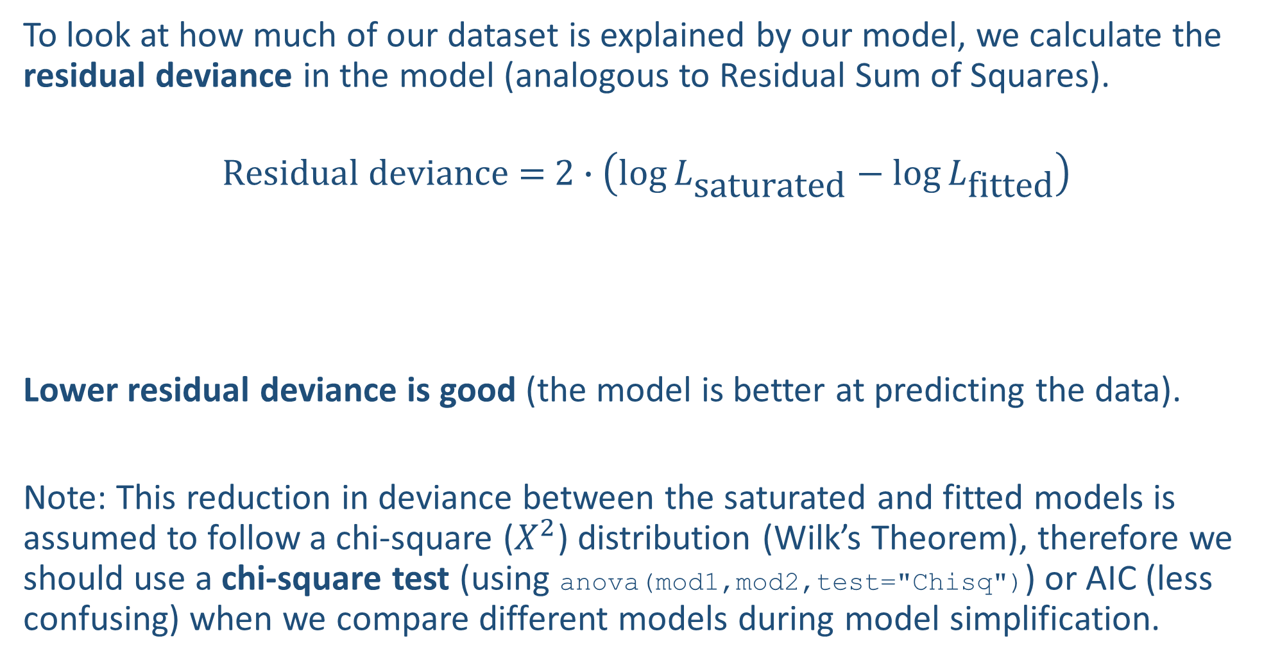
Residual deviance
To look at how much of our dataset is explained by our model, we calculate the residual deviance in the model (analogous to Residual Sum of Squares).
$$\text{Residual} \text{deviance}\text{ = }2∙\left(\log{L_{\text{saturated}}}−{\log{L}}_{\text{fitted}}\right)$$
Lower residual deviance is good (the model is better at predicting the data).
Note: This reduction in deviance between the saturated and fitted models is assumed to follow a chi-square ($X^{2}$) distribution (Wilk’s Theorem), therefore we should use a chi-square test (using anova(mod1,mod2,test="Chisq")) or AIC (less confusing) when we compare different models during model simplification.
Likelihood of a saturated model, i.e. a model where there is one parameter for each datapoint and all the datapoints are therefore perfectly explained
The Likelihood of our model (that we just fit) that we want to calculate the Residual deviance for

Slide 15
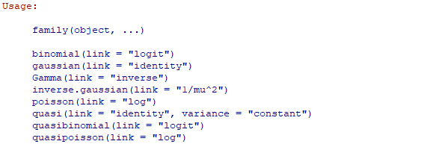
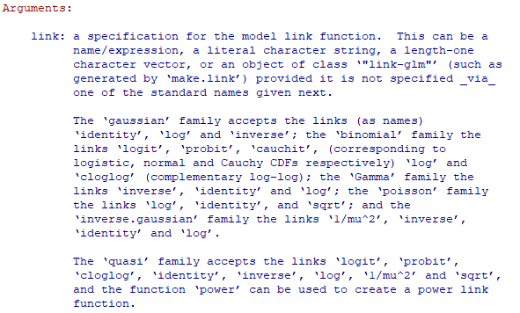
Fitting a GLM
Function to fit GLMs (from Base R)
Specifying an error distribution. We change this argument to specify different distributions. Check help(family) to see how.
General code:
modelObject=glm(Y~X1*X2+X3/X4,family=gaussian,data=dataset)
The canonical link function is used by default
- You can specify a different link function, e.g.:
family=gaussian(link="inverse")
- To see what link functions are allowed for each distribution:
?family or help(family)
Note: I don’t suggest you change the link function until you’re more familiar with the theory and math behind GLMs.
Formula of response and explanatory variables. Can have interacting and nested variables.
Name of dataframe object containing all the variables to be used
Object to save the fitted model to

Slide 16
Advanced analyses – Analysis decision tree
(will be modified further)
Normally distributed (errors):
Regression^*
Not normally distributed (errors):
Generalised Linear Model (GLM) with error structure to be determined by you
Start
All Continuous
Response variable type
Continuous
Explanatory variables types
All Categorical
Normally distributed (response):
Analysis of variance (ANOVA)^*
Not normally distributed (response):
Kruskal-Wallis test or GLM
Categorical
Continuous and Categorical
Time to Death
Count
Number of categories
Normally distributed (response):
Analysis of covariance (ANCOVA)^*
Not normally distributed (response):
Rank-based ANCOVA (RANCOVA) or
GLM with error structure to be determined by you
Proportion
2
>2
GLM with Poisson errors (aka Poisson regression)
No
^Heteroscedasticity: use GLS
*Random effects: use LME
Overdispersion present?
GLM with Binomial errors (aka Binary Logistic regression)
Yes
Survival Analysis
GLM with Binomial errors (aka Logistic regression)
GLM with Quasi-Poisson errors or
GLM with Negative Binomial errors
GLM with Multinomial errors (aka Multinomial Logistic regression)

Slide 17
Poisson GLM
Count data

Slide 18
When to use?
Your response variable is a count: e.g. the number of times an event happened.
- Cannot be less than zero (there is a bound, aka a limit, at zero).
- Zero is quite common.
- Variance is not constant, it increases with the mean.
- You don’t know the number of times the event did not happen (if you did, it would be proportion data).
Examples:
- Number of cheetahs observed within a nature reserve based on the size of the reserve and its connectivity to other reserves.
- Number of cancers detected explained by distance from the patient’s home to a nuclear power plant.

Slide 19

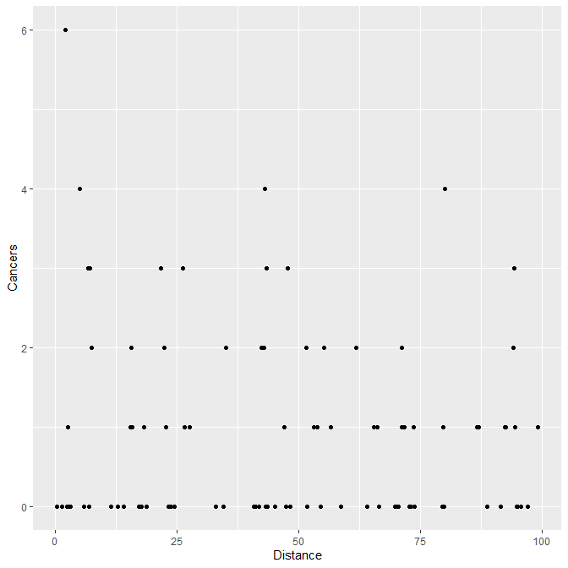
Poisson Example 1: Fitting
Number of cancers detected explained by distance (km) from the patient’s home to a nuclear power plant.
#Load and visualise dataset
d1=read.table("clusters.txt",header=T)
str(d1)
library(ggplot2)
ggplot(d1,aes(x=Distance,y=Cancers))+geom_point()
#The response variable is a count, so we fit a GLM with Poisson errors
mod1.1=glm(Cancers~Distance,family=poisson,data=d1)
Looks like there may be a weak negative correlation

Slide 20
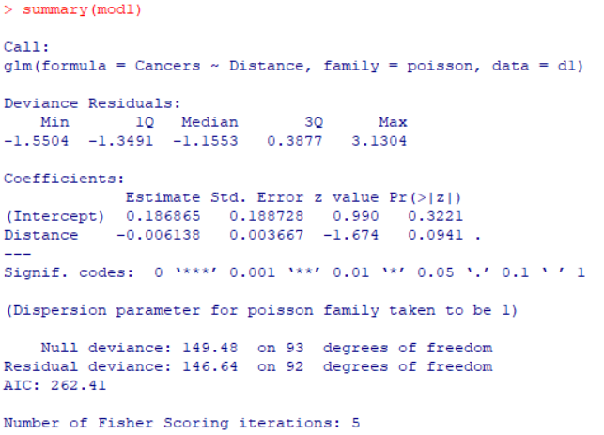
Poisson Example 1: Interpreting results
P-value is not significant.
Deviance if it were a null model (i.e. with no explanatory variables). The residual deviance and d.f. for your model should be lower than this.
summary(mod1.1)
We cannot use these results because there is overdispersion: specifically, Residual deviance > degrees of freedom.
Distribution of the deviance for all datapoints (a bit hard to interpret because it’s still in the units of the linear predictor).
This is the residual deviance of your model and is used to judge whether there is overdispersion…
Residual deviance ≈ d.f.: good.
Residual deviance < d.f.: underdispersion, usually no need to correct.
Residual deviance > d.f.: overdispersion, correct for this by using quasipoisson or negative binomial.
The “effect size” (together with uncertainty estimate) of your explanatory variable, but in the units of the linear predictor.
Number of trials required for R to numerically end up with the coefficients in your model.

Slide 21
Overdispersion
Guideline: Residual Deviance:d.f. ratio < 1.5 is generally OK. Anything ≥ 1.5, you should think about correcting for overdispersion.
Overdispersion is extra unexplained variation in the response variable.
- The error distribution we use assumes a certain relationship between the variance and the mean in the data, e.g. Poisson assumes: variance = mean.
- If there is more variance than expected, we may have missed an important explanatory variable or the relationship between the explanatory and response variables is not linear.
If these are not the case, then the data may not fit the Poisson distribution we have chosen. Therefore, we can switch the error distribution to:
- Quasipoisson: uses quasi-likelihood which allows the variance to vary by fitting a dispersion parameter; when simplifying, use anova(mod1,mod2,test="F") (cannot use AIC);
OR
- Negative binomial (can use AIC)

Slide 22
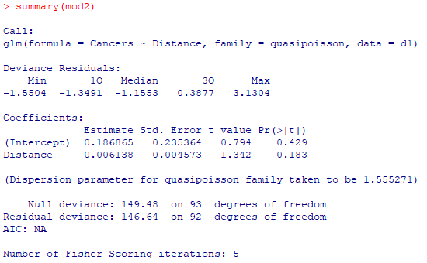
Poisson Example 1: Re-Fitting with Quasipoisson errors
#Fit and view results
mod1.2=glm(Cancers~Distance,family=quasipoisson,data=d1)
summary(mod1.2)
Remember: to simplify with quasipoisson, use anova(mod1,mod2,test="F") not AIC.
The effect is not significant. Perhaps we are missing an important explanatory variable?
The estimated dispersion parameter: the variance was about 1.55x what was expected.
Because there’s no likelihood function, we cannot calculate an AIC value for quasipoisson models. That’s why we have to use anova() and specify an F-test instead.
Residual deviance doesn’t change but it’s OK because we have accounted for it by using quasipoisson

Slide 23
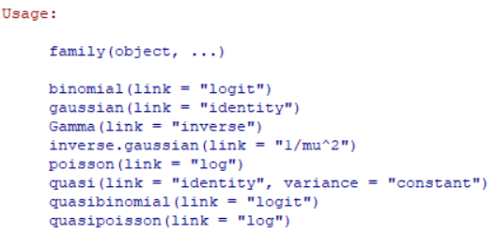
Poisson Example 1: Interpreting results with Quasipoisson errors
Therefore the Activation Function (to convert the linear predictor back to the original units of the y-variable) is the exponential
#Check the link function
help(family)
#Calculate number of cancers at Distance = 0 (i.e. the intercept)
exp(0.186865) #1.205
#Number of cancers at Distance = 1 km
exp(0.186865-0.006138) #1.198
Because it’s QUASIpoisson, there are no assumptions to check
This is the value of the linear predictor when Distance = 0
This is the change in the value of the linear predictor for a unit increase of Distance

Slide 24
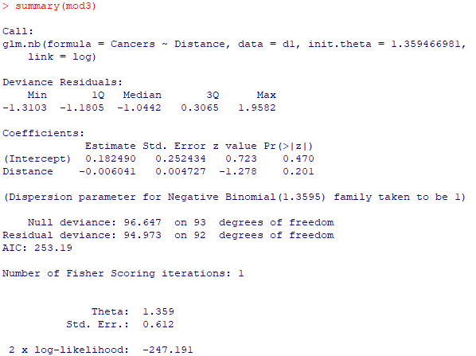
Poisson Example 1: Re-Fitting with Negative Binomial errors
Similar results, the effect is non-significant.
#Fit and view results
require(MASS)
mod1.3=glm.nb(Cancers~Distance,data=d1)
summary(mod1.3)
Note: to simplify, you can use AIC(mod1,mod2) or anova(mod1,mod2,test="Chisq") to compare models
We can calculate AIC with negative binomial (that’s why I personally prefer it over quasipoisson)
Residual deviance now about equal to d.f.

Slide 25
Poisson Example 1: Interpreting results with Negative Binomial errors
#Number of cancers at Distance = 0 (i.e. the intercept)
exp(0.182490) #1.200
#Number of cancers at Distance = 1 (whatever units it is in)
exp(0.182490-0.006041) #1.193
Results are very similar to the quasipoisson (1.205 and 1.198).
Conveniently provided in the summary

Slide 26
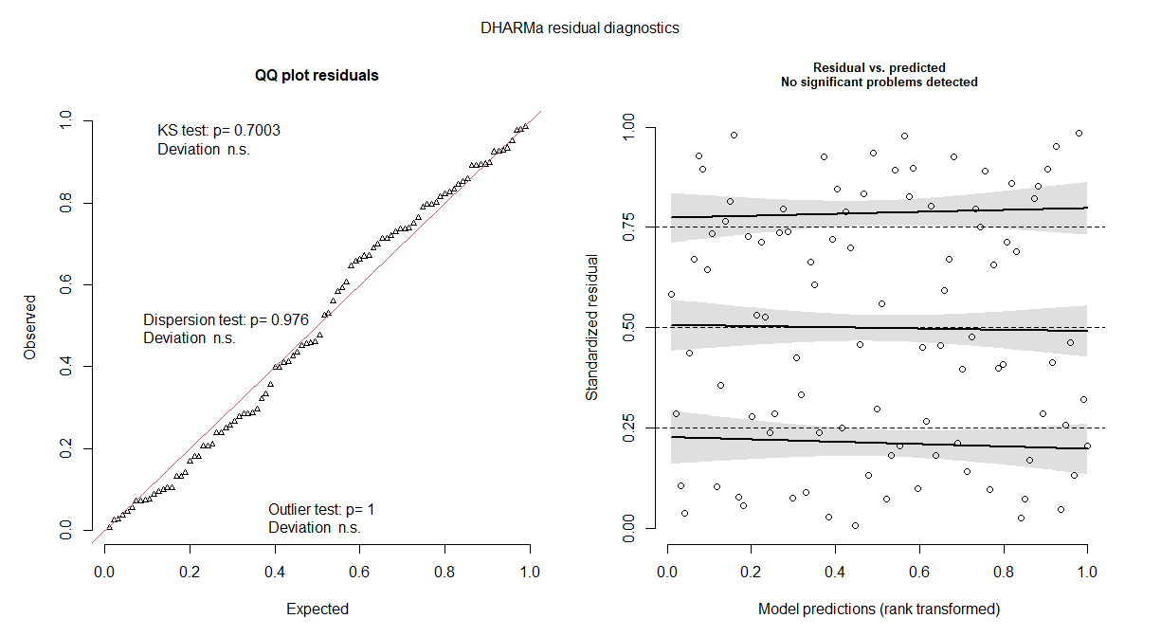
Poisson Example 1: Diagnostics to check models
Quasipoisson: not needed (because it doesn’t make any assumptions).
Negative binomial: possible (but not widely practiced).
#Install package
require(DHARMa) #can take awhile
plot(simulateResiduals(mod1.3))
- Problems will be highlighted in red, so no problems here.
- If there are problems, it’s not easy to solve: check whether you have left out important variables, whether the relationship is non-linear, etc.
Kolmogorov-Smirnov test: used to test whether the datapoints come from a particular distribution (p-value > 0.05 means yes – good!)
Graphical test for patterns in residuals (i.e. deviance). You want this to follow the black dotted lines
Test for outliers: p-value > 0.05 is good.
Test for overdispersion: p-value > 0.05 is good.

Slide 27
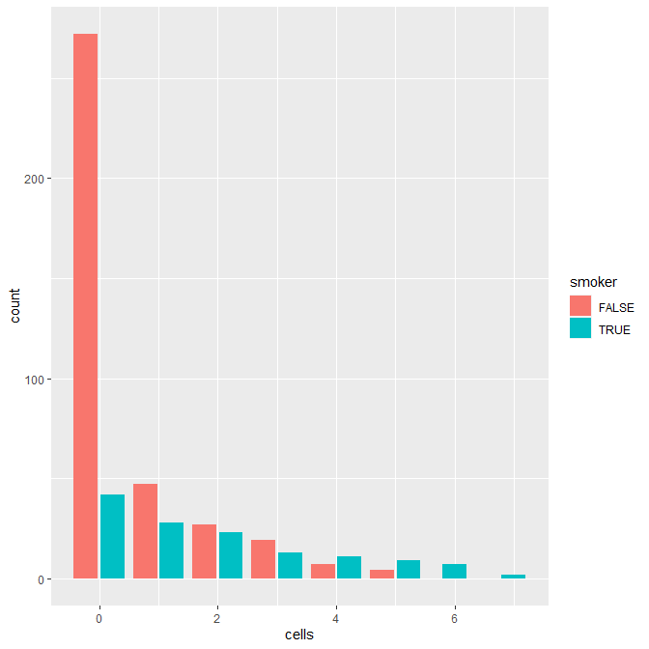
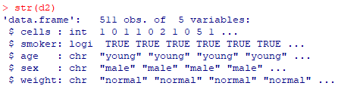
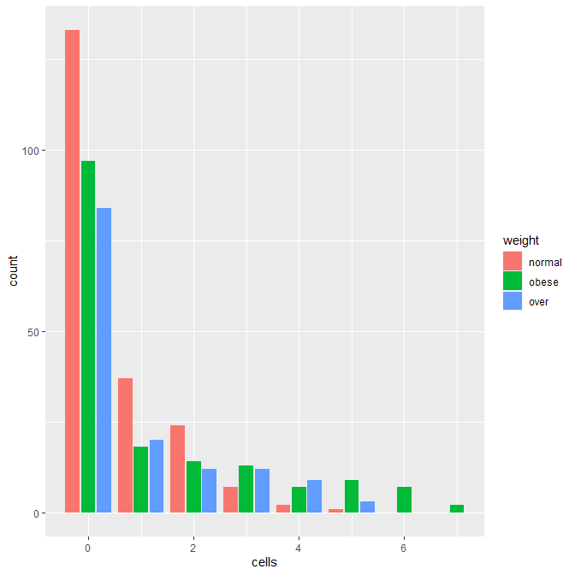
Poisson Example 2: Fitting
Number of diseased blood cells (count) explained by smoker status (yes/no), age (3 levels), sex (male/female) and body weight (3 levels).
#Load dataset
d2=read.table("cells.txt",header=T)
str(d2)
#Slightly more tricky to visualise
#Barplot of counts (but cannot view interactions)
ggplot(d2,aes(x=cells))+geom_bar(aes(fill=smoker), position=position_dodge2(preserve="single"))
ggplot(d2,aes(x=cells))+geom_bar(aes(fill=weight), position=position_dodge2(preserve="single"))
Many non-smokers have fewer diseased cells, and those with more diseased cells tend to be smokers
Many with normal weight have fewer diseased cells, and those with more diseased cells tend to be overweight or obese
This keeps the blue bar skinny even when there is no pink bar
This argument positions the blue and pink bars side-by-side instead of stacked on top of each other. If there’s no “2”, there will be no space between bars

Slide 28
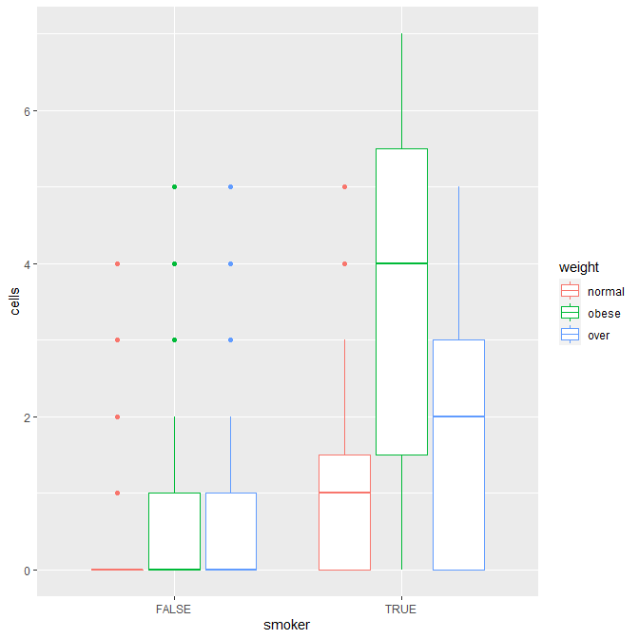
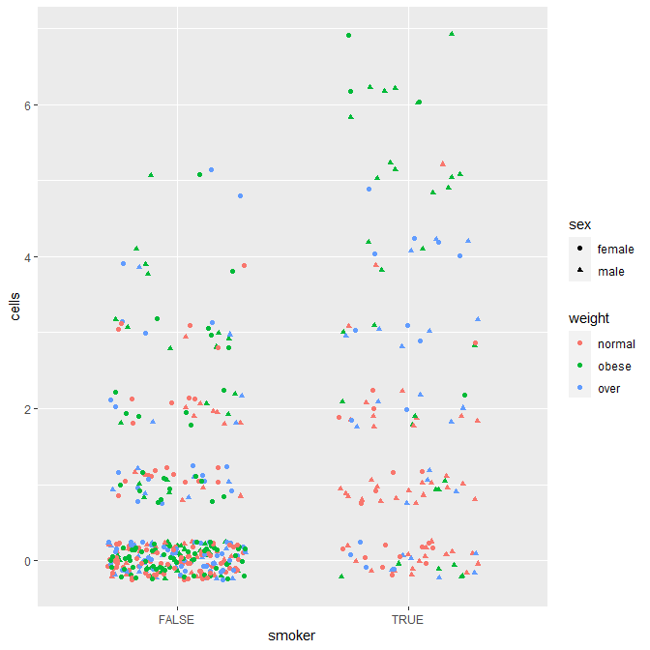
Poisson Example 2: Fitting
#Boxplot (not OK for publication, but OK to help you see interactions)
ggplot(d2,aes(x=smoker,y=cells))+geom_boxplot(aes(col=weight))
#Scatterplot (also just to help you see more interactions)
ggplot(d2,aes(x=smoker,y=cells))+geom_jitter(aes(col=weight),width=0.3)
Being both a smoker and obese seems to increase the number of diseased cells
Tend to be many obese individuals near the top, especially for smokers.
No obvious pattern between males and females.

Slide 29
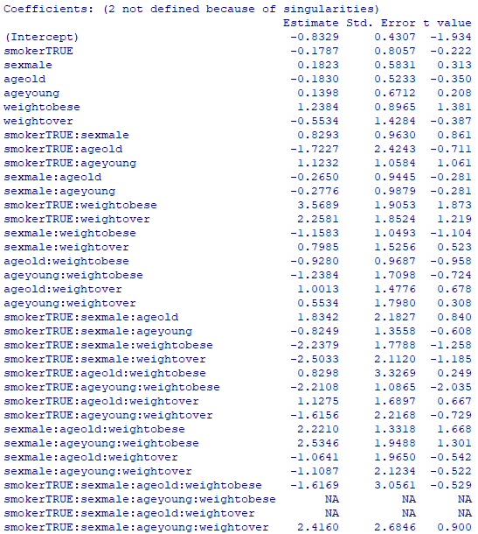

Poisson Example 2: Fitting
#Fit Poisson model
mod2.1=glm(cells~smoker*sex*age*weight,family=poisson,data=d2)
summary(mod2.1)
#Residual deviance 736.33, d.f. = 477: overdispersion is present
#Fit Quasipoisson
mod2.2=glm(cells~smoker*sex*age*weight,family=quasipoisson,data=d2)
summary(mod2.2)
ALOT of results! Note there are some NAs because those factor level combinations have no data in them

Slide 30
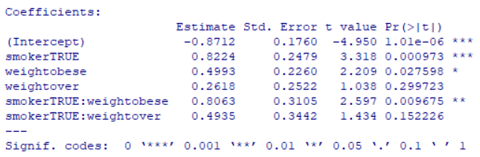
Poisson Example 2: Simplifying
Notes on step() and stepAIC()
- step() works with Poisson, binomial and negative binomial GLMs. It does NOT work with quasipoisson or quasibinomial.
- Both step() and stepAIC() use AIC; step() is a simplified form of stepAIC() so they should give similar results.
- If step() does not work, use stepAIC() from the MASS package.
#Remove most complicated term first: 4-way interaction
mod2.3=update(mod2.2,~.-smoker:sex:age:weight)
#Compare using F-test (recall that AIC will not work for quasipoisson)
anova(mod2.2,mod2.3,test="F")
#No difference, so we prefer the simplified model
.
. (simplify manually, unfortunately step() does not work with quasipoisson)
.
#Final minimum adequate model
mod2.14=glm(cells~smoker*weight,family=quasipoisson,data=d2)
summary(mod2.14)

Slide 31
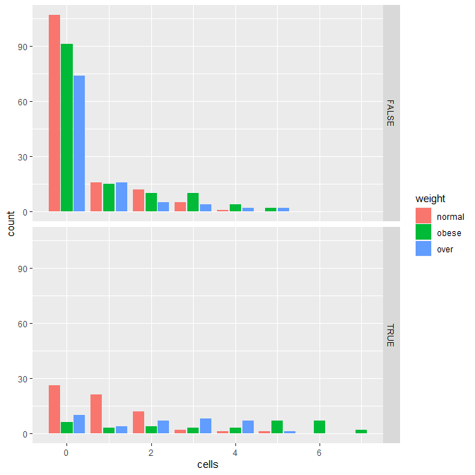
Poisson Example 2: Visualising results
#Faceting by <smoker> (True or False) to see 2-way interaction
ggplot(d2,aes(x=cells))+
geom_bar(aes(fill=weight),position= position_dodge2(preserve="single"))+
facet_grid(smoker~.)
Interpretation: for non-smokers, the difference between people of normal weight and those who are obese/over is not so large; whereas for smokers, this difference is more obvious (those who are normal weight have fewer diseased cells).
This breaks up the plot into subplots vertically (y-axis) by the levels in <smoker>

Slide 32
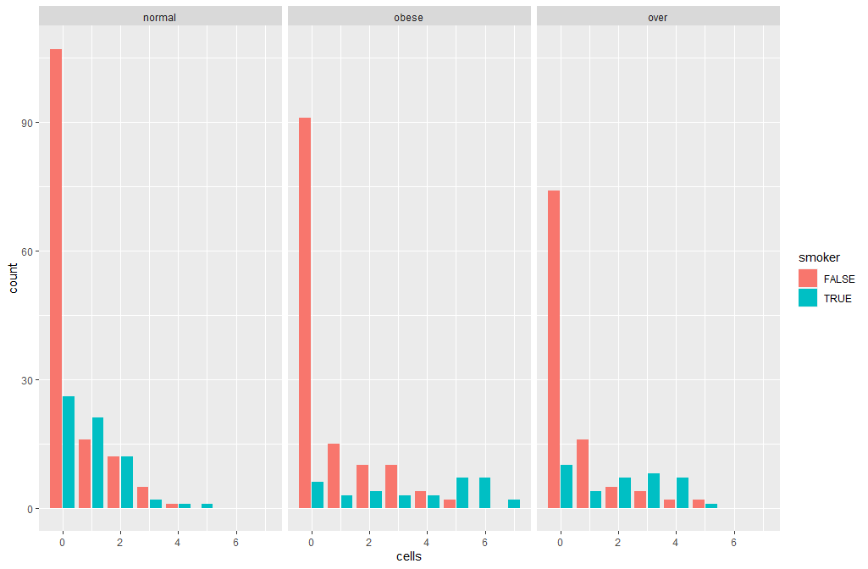
Poisson Example 2: Visualising results
#Faceting by <weight> (normal, obese or over)
ggplot(d2,aes(x=cells))+
geom_bar(aes(fill=smoker),position=position_dodge2(preserve="single"))+
facet_grid(.~weight)
Interpretation: for people of normal weight, both smokers and non-smokers have similar numbers of diseased cells; whereas for those who are obese/over, smokers tend to have more diseased cells.
This breaks up the plot into subplots horizontally (x-axis) by the levels in <weight>

Slide 33
Binomial GLM
Proportion data and Categorical data with 2 categories

Slide 34
When to use?
Situation 1: Your response variable is a proportion: i.e. you know the number of “successes” and the number of “failures” (previously with Poisson, you only know the number of “successes”).
- Example: Number of coral colonies alive vs. dead, explained by water temperature and pollution levels on a coral reef.
Situation 2: Your response variable is categorical and can take one of two values i.e. binary (e.g. A or B, infected or not infected, male or female).
- Example: Successful or failed conservation solution, explained by funding and country.
Recall Lecture 3:
- If you simply want to compare a proportion to a constant, use binom.test()
- If you simply want to compare two proportions to each other, use prop.test()

Slide 35
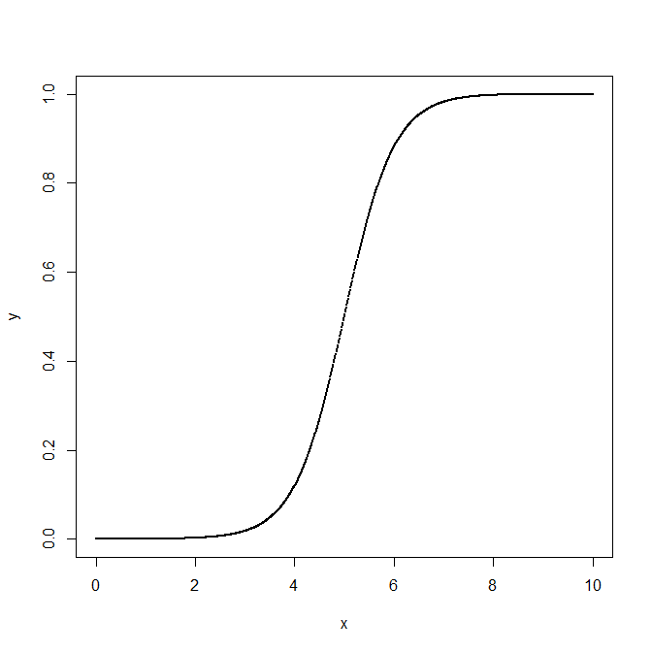

Situation 1: a binomial GLM on proportion data
Logistic curve: $y= \frac{1}{1+e^{−2\left(x−5\right)}}$
Proportion data are strictly bounded above (at 1) and below (at 0). A logistic activation function is perfect because it can be made to asymptote at 0 and 1.
Assuming n is sample size, p is the proportion of successes and q is the proportion of failures (note that p + q = 1):
- The mean (number of successes) = np.
- The variance in the binomial distribution, s² = npq. s² is therefore lowest (i.e. 0) when p = 0 or p = 1 and maximum when p = 0.5.
Note: when n is large and p is close to 0, the binomial distribution converges with the Poisson distribution (in English: if you have a large dataset and the probability of successes is quite low, you could use a Poisson instead).

Slide 36
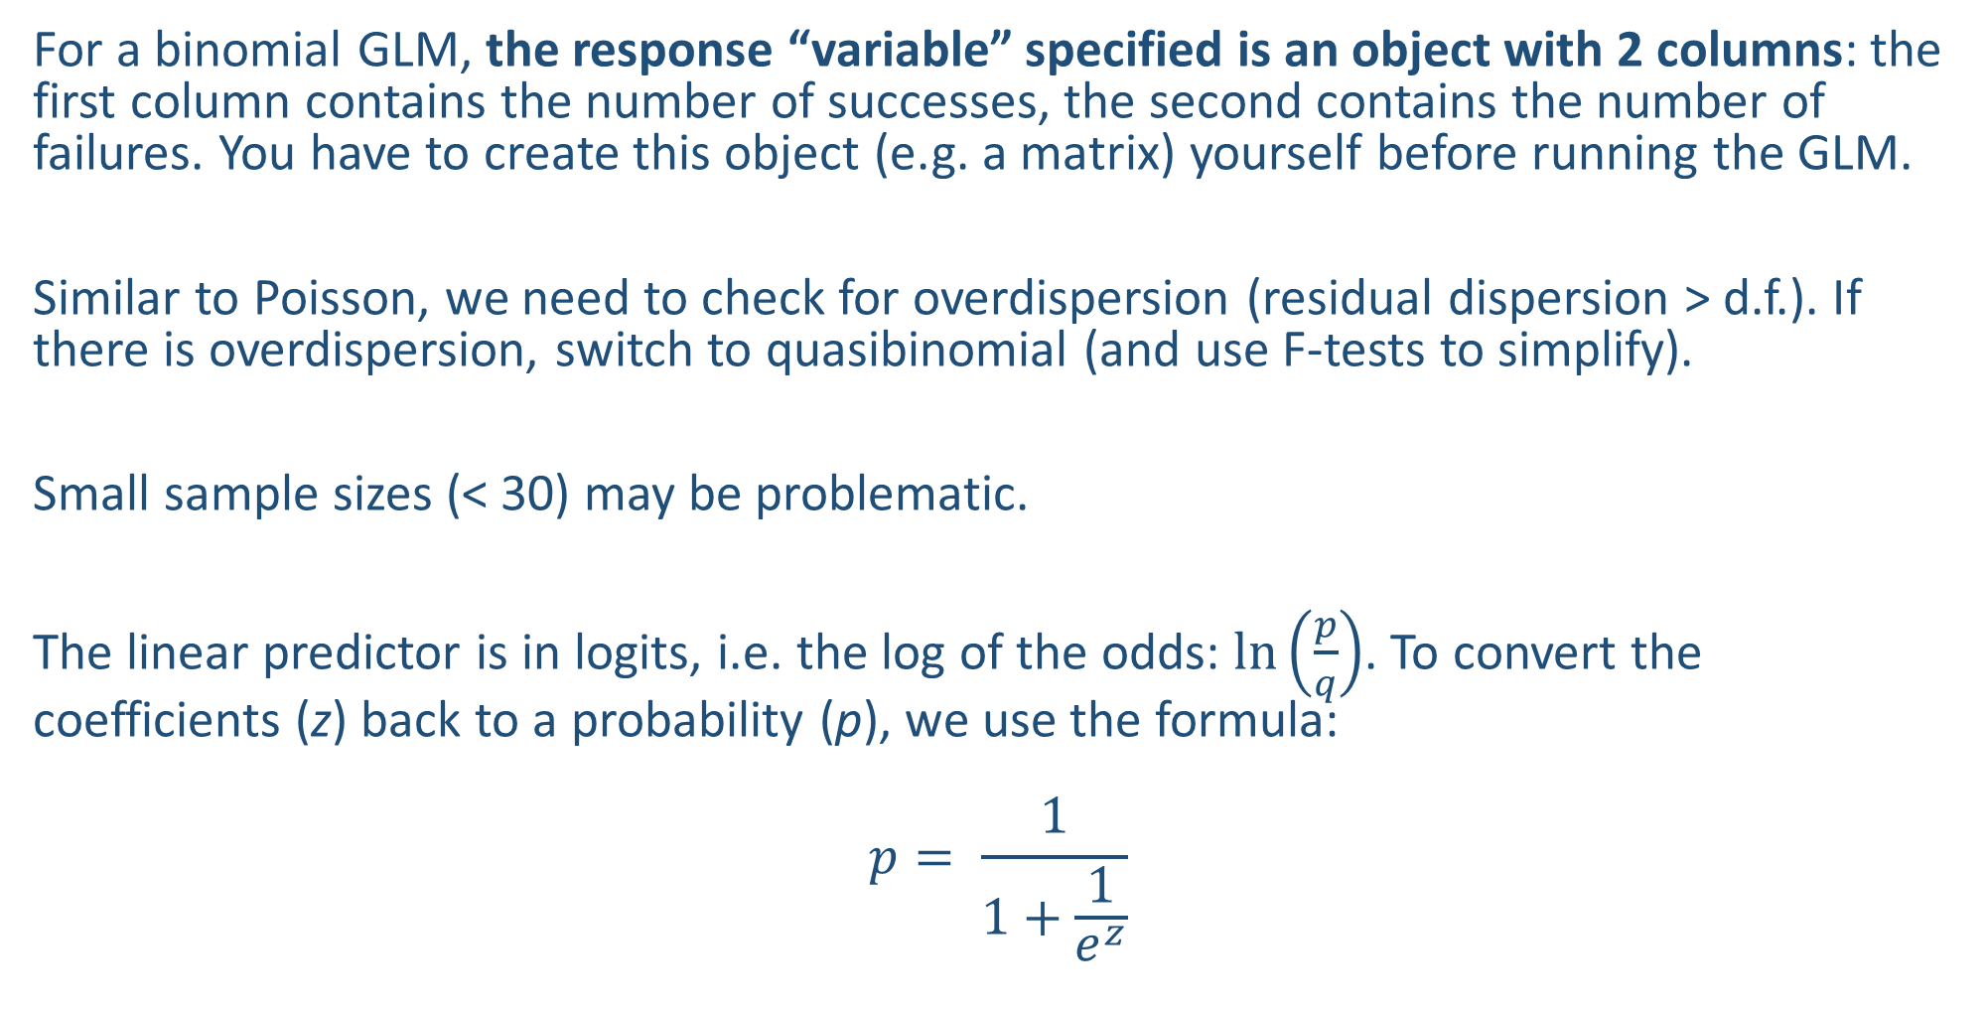
Before we fit the model…
For a binomial GLM, the response “variable” specified is an object with 2 columns: the first column contains the number of successes, the second contains the number of failures. You have to create this object (e.g. a matrix) yourself before running the GLM.
Similar to Poisson, we need to check for overdispersion (residual dispersion > d.f.). If there is overdispersion, switch to quasibinomial (and use F-tests to simplify).
Small sample sizes (< 30) may be problematic.
The linear predictor is in logits, i.e. the log of the odds: $\ln\left(\frac{p}{q}\right)$. To convert the coefficients (z) back to a probability (p), we use the formula:
$$p= \frac{1}{1+\frac{1}{e^{z}}}$$
(Sorry: Math. But this is important for reporting effect sizes.)

Slide 37
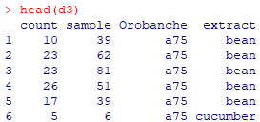
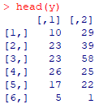
Binomial Example: Fitting
Predicting germination success of a parasitic plant based on its genotype <Orobanche> on the host plant <extract> (allowing the two x-variables to interact). The response variables provided are the number of successful germinations <count>, and the total number of trails for each batch <sample>.
#Read in the dataset
d3=read.table("germination.txt",header=T)
head(d3)
Create the “y-variable”: the first column contains the number of successes, which is <count>, and the second column contains the number of failures, which is <sample> minus <count>:
y=cbind(d3$count,d3$sample-d3$count)
head(y)

Slide 38
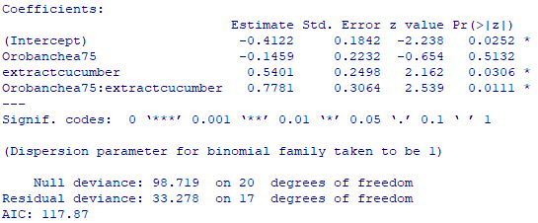
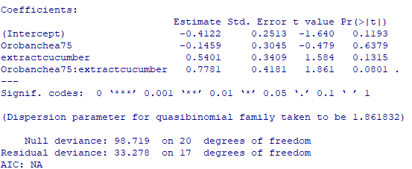
Binomial Example: Fitting
Fit the binomial GLM
mod3.1=glm(y~Orobanche*extract,family="binomial",data=d3)
summary(mod3.1)
Looks like there’s overdispersion, so we switch to quasibinomial:
mod3.2=glm(y~Orobanche*extract,family="quasibinomial",data=d3)
summary(mod3.2)#The interaction is no longer significant
No need to check assumptions because it is quasibinomial
Remember this is now OK because we have accounted for it by using quasi-likelihood

Slide 39
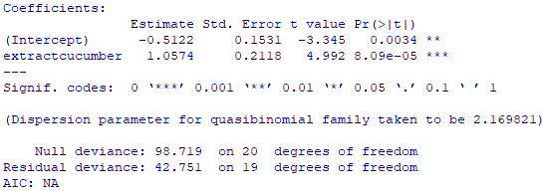
Binomial Example: Simplifying
#Remove interaction
mod3.3=update(mod3.2,~.-Orobanche:extract)
anova(mod3.2,mod3.3,test="F") #p-value=0.081 so we use the simpler model
summary(mod3.3)
#Remove <Orobanche> (p-value=0.25)
mod3.4=update(mod3.3,~.-Orobanche)
anova(mod3.3,mod3.4,test="F") #p-value=0.25
summary(mod3.4)
Final model: only <extract> is significant, i.e. there is a significant difference between germination rates for bean vs. cucumber extracts, but not for different genotypes
Remember we now have to use F-test because it is quasi-likelihood

Slide 40


Binomial Example: Interpreting coefficients to extract effect size
We are trying to calculate the rate of germination for each of the 2 different levels of <extract>, bean and cucumber. The intercept in this case represents bean.
Recall:
#Calculate germination rate for bean
1/(1+1/exp(-0.5122)) #0.3746
#Germination rate (i.e. p of success) in bean is 37.5%
#Calculate germination rate for cucumber
1/(1+1/exp(-0.5122+1.0574)) #0.6330
#Germination rate in cucumber is 63.3%
This is the z for beans
$$p= \frac{1}{1+\frac{1}{e^{z}}}$$
This is the DIFFERENCE between the z for beans and the z for cucumber
Note: it is also possible to use tapply() and predict() with type=“response” to convert and extract the values:
tapply(predict(mod3.4,type="response"),d3$extract,mean)

Slide 41
Situation 2: a binomial GLM on categorical (binary) data
Exactly the same, except the response variable specified is a categorical variable (from the dataset) with two unique values in it
- Examples:. A and B; T and F; 1 and 2
- Best to make sure it is either a factor or chr type

Slide 42
Multinomial GLM
Categorical data with >2 categories

Slide 43
When to use?
Similar to binomial when your response variable is categorical, but here it can take >2 values.
A multinomial GLM tells you whether one combination of all the categories is different from another combination of all the categories
It only tells you whether there is an overall difference (similar to an ANOVA).
- You will then have to compare each pair of categories using a binomial GLM to see what is driving the difference (similar to pairwise t-tests).
Example:
Predict IUCN category of species (6 categories, from Least Concern to Extinct) based on their biogeographic home region and body size.
A
B
C
D
vs.
A
B
C
D
A
vs.
B
A
B
A
C
A
C
A
D
A
D
vs.
vs.
etc.

Slide 44
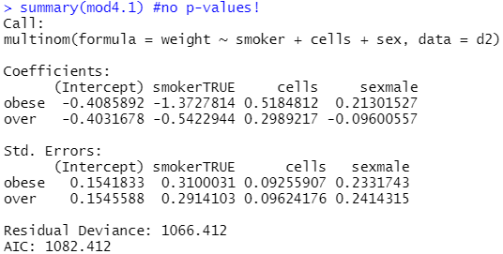
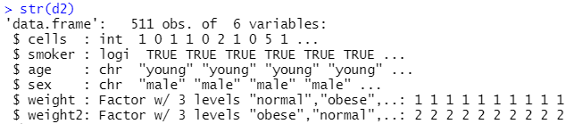
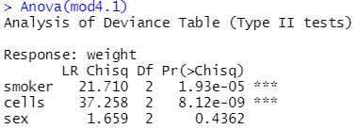
Multinomial Example: Fitting
Categorical variable <smoker>: shows the difference between smokers and non-smokers for obese vs. normal
Continuous variable <cells>: shows slope for obese vs. normal
Back to the <cells> dataset! Can we explain a person’s weight by their sex, whether they smoke, how many diseased cells they have?
d2=read.table("cells.txt",header=T)
d2$weight=as.factor(d2$weight)
str(d2)
<weight> has 3 levels, so do multinomial GLM:
require(nnet)
mod4.1=multinom(weight~smoker+cells+sex,data=d2)
summary(mod4.1) #only effect sizes, no p-values!
Get overall p-value for each variable:
require(car)
Anova(mod4.1)
Note: diagnostic tests are not (yet) possible for multinomial GLM.
These are the effect size and uncertainty for the same coefficient
As effect sizes, you can report the actual percentages in the data instead of these figures
All significant except <sex>
Notes:
ANOVA Type I test: test significance while adding variables sequentially.
Type II: Test each variable assuming the other variable(s) is in the model, assuming no interaction
Type III: Test each variable assuming the other variable(s) is in the model, assuming an interaction

Slide 45


Multinomial Example: Comparing all levels
Compare all other levels to the reference level (by default, the first level alphabetically) using Wald tests to get p-values
z1=summary(mod4.1)$coefficients/summary(mod4.1)$standard.errors
p1=(1-pnorm(abs(z1),0,1))*2
To change to a different reference level, we create a “new” y-variable to run a new model
d2$weight2=relevel(d2$weight,ref="obese")
mod4.2=multinom(weight2~smoker+cells+sex,data=d2)
summary(mod4.2)
z2=summary(mod4.2)$coefficients/summary(mod4.2)$standard.errors
p2=(1-pnorm(abs(z2),0,1))*2
Note: releveling can also be used to compare different levels in lm() models.
Compares everything to “normal”
Create the new variable <weight2> and fit another GLM
<weight> lists “normal” first, <weight2> lists “obese” first

Slide 46
Quasi GLM
Non-normal continuous data

Slide 47
When to use?
You have a continuous response variable (ideally not a count, proportion or time to event) that is not normally distributed. You don’t want to/cannot transform your y-variable or use a nonparametric test, or these do not work.
“Quasi” models do not assume any error distribution at all (similar to the quasipoisson and quasibinomial), and use a “dispersion parameter” to try to account for the dispersion in the model.
Example: you want to explain height of a group of people using nutritional status (continuous) and sex (categorical), but when you fit the ANCOVA, the shapiro.test() shows that the data are not normally distributed. You try square root followed by log (and all other transforms) but it does not work.
WARNING: treat quasi GLMs as your last resort. They are relatively new and still not widely implemented.

Slide 48
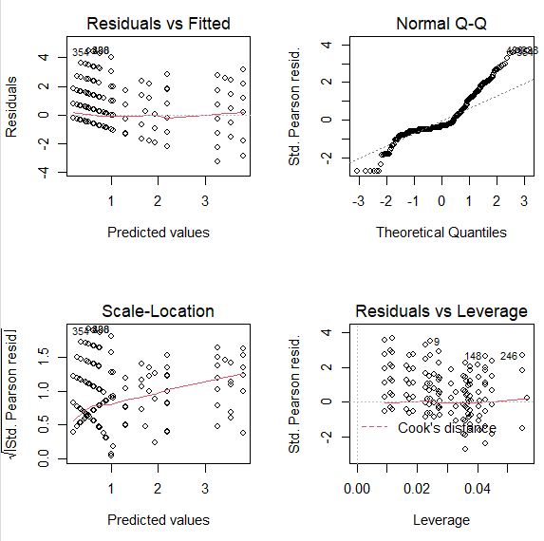
Quasi Example: Fitting
Back to the <cells> dataset again!
#Read in dataset
d2=read.table("cells.txt",header=T)
#Fit GLM with Gaussian distribution—this is exactly the same as running an lm() (recall that we used lm() for regression, ANOVA and ANCOVA):
mod5.1=glm(cells~sex/age+smoker*weight,family="gaussian",data=d2)
Check assumptions:
par(mfrow=c(2,2))
plot(mod5.1) #clearly non-normal errors

Slide 49
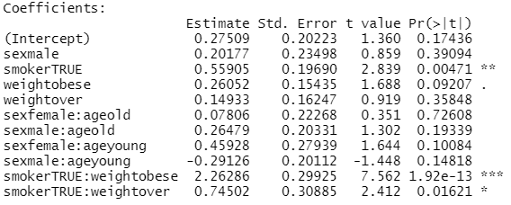
Quasi Example: Fitting
Fit quasi model:
mod5.2=update(mod5.1,family="quasi")
summary(mod5.2)
Then proceed with manual simplification until you arrive at your minimum adequate model :
- In this case I would remove <age> nested within <sex> first
Note: because this is also quasi-likelihood, there are no assumptions to check.
Answer

Slide 50
Summary (Learning Objectives)
Generalised Linear Models (GLM)
- Theory: Link functions, linear predictors and error distributions
Error distributions and variable types
Least Squares vs. Maximum Likelihood
- Poisson for count data
Quasipoisson/Negative Binomial for overdispersion
Simplifying, comparing, checking and interpreting models
- Binomial for proportion/categorical data (2 categories)
Quasibinomial for overdispersion
Simplifying, comparing, checking and interpreting models
- Multinomial for categorical data (>2 categories)
- Quasi as a last resort for non-normally distributed continuous data

